Slide 1
08.
CSS Reset
CSS의 절대 권력 : 초기화.

Slide 2
reset.css
/* http://meyerweb.com/eric/tools/css/reset/
v2.0 | 20110126
License: none (public domain)
*/
html, body, div, span, applet, object, iframe,
h1, h2, h3, h4, h5, h6, p, blockquote, pre,
a, abbr, acronym, address, big, cite, code,
del, dfn, em, img, ins, kbd, q, s, samp,
small, strike, strong, sub, sup, tt, var,
b, u, i, center,
dl, dt, dd, ol, ul, li,
fieldset, form, label, legend,
table, caption, tbody, tfoot, thead, tr, th, td,
article, aside, canvas, details, embed,
figure, figcaption, footer, header, hgroup,
menu, nav, output, ruby, section, summary,
time, mark, audio, video {
margin: 0;
padding: 0;
border: 0;
font-size: 100%;
font: inherit;
vertical-align: baseline;
}
/* HTML5 display-role reset for older browsers */
article, aside, details, figcaption, figure,
footer, header, hgroup, menu, nav, section {
display: block;
}
body {
line-height: 1;
}
ol, ul {
list-style: none;
}
blockquote, q {
quotes: none;
}
blockquote:before, blockquote:after,
q:before, q:after {
content: '';
content: none;
}
table {
border-collapse: collapse;
border-spacing: 0;
}
reset.css(1kB)
Eric A. Meyer
마지막 업데이트: 2011년 1월
https://meyerweb.com/eric/tools/css/reset/

Slide 3
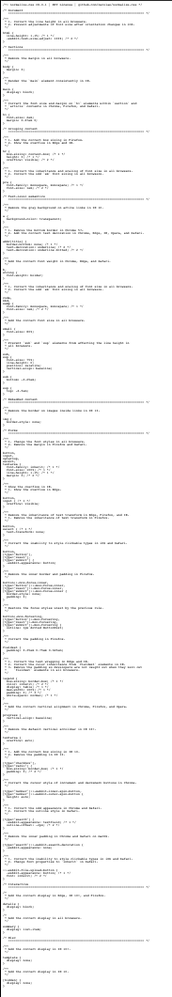
reset.css
normalize.css(1.3kB)
necolas
마지막 업데이트: 2018년 11월
https://github.com/necolas/normalize.css/blob/master/normalize.css

Slide 4
Overridden / Unused CSS

Slide 5
Overridden / Unused CSS
footer, header, hgroup, menu, nav, section {
display: block;
}
ol, ul {
list-style: none;
}
blockquote, q {
quotes: none;
}
blockquote:before, blockquote:after,
q:before, q:after {
content: '';
content: none;
}
table {
border-collapse: collapse;
border-spacing: 0;
}
현재 시점에서 굳이 선언하지 않아도 되는
스타일이 대부분.(reset.css)

Slide 6
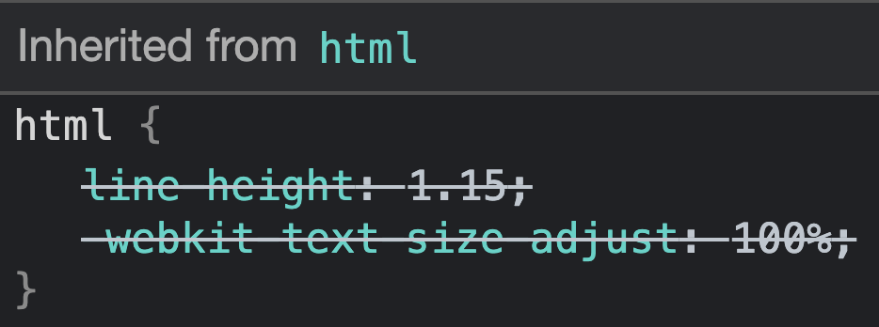
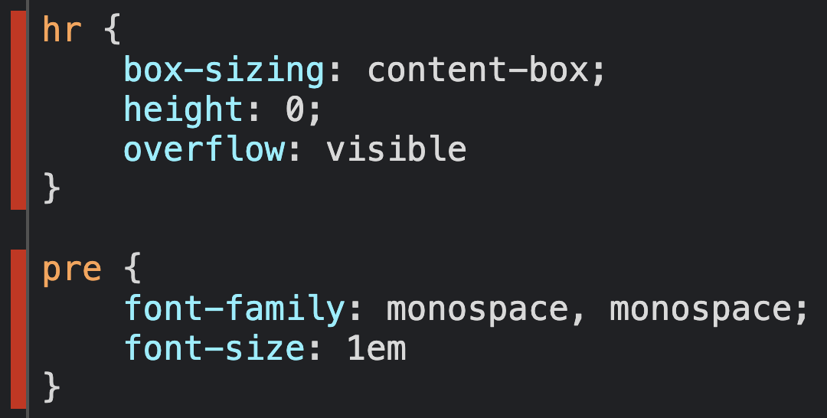
Overridden / Unused CSS
Overridden(normalize.css)
Unused(normalize.css)

Slide 7
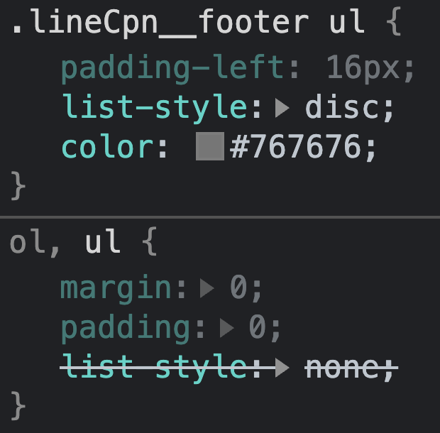
Overridden / Unused CSS
Overridden(base.css)

Slide 8
Universal selector * reset

Slide 9
Universal selector * reset (Do not)
*,
::before,
::after {
margin: 0;
padding: 0;
border: 0;
box-sizing: border-box;
background-color: transparent;
border-collapse: collapse;
border-spacing: 0;
list-style: none;
-webkit-appearance: none;
appearance: none;
}

Slide 10
Find unused CSS

Slide 11
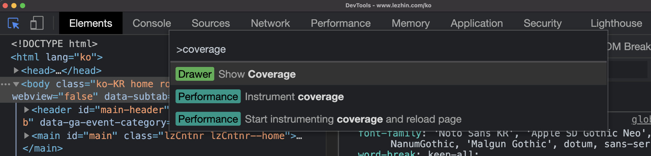
Find unused CSS (Show Coverage)
Chrome - DevTools
Mac: Cmd + Shift + P + (coverage)
Win: Ctrl + Shift + P + (coverage)
https://developer.chrome.com/docs/devtools/shortcuts/

Slide 12
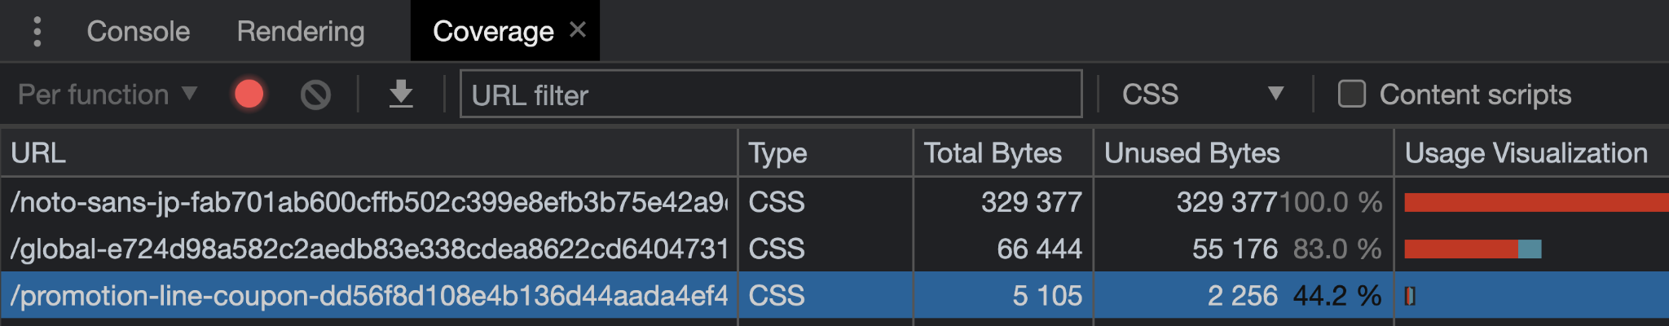
Find unused CSS (Show Coverage)
Chrome - DevTools - Coverage Tab
https://developer.chrome.com/docs/devtools/coverage/

Slide 13
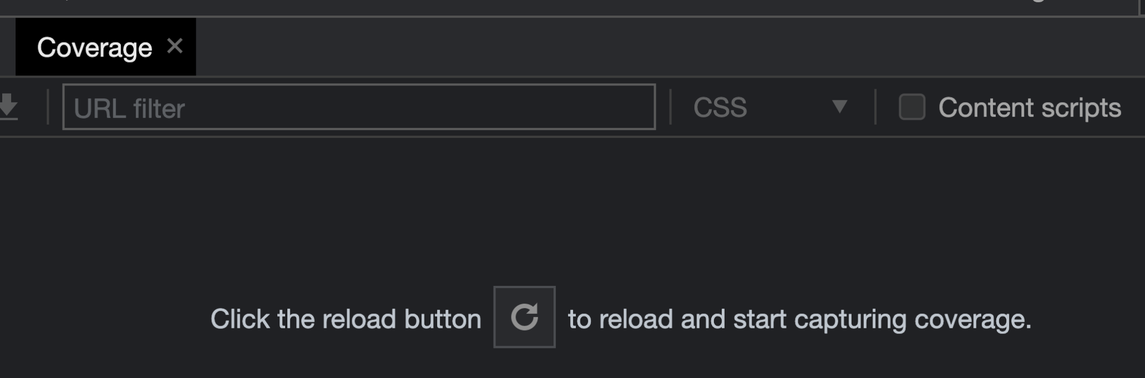
Find unused CSS (Show Coverage)
Chrome - DevTools - Coverage Tab
https://developer.chrome.com/docs/devtools/coverage/

Slide 14
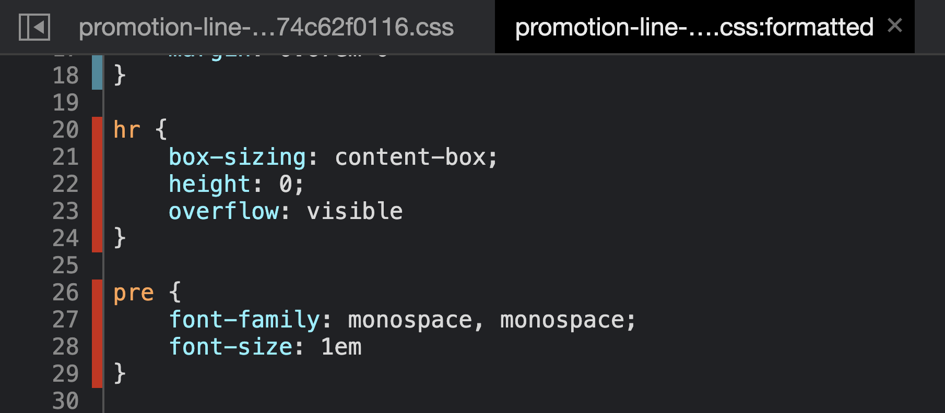
Find unused CSS (Show Coverage)
Chrome - DevTools - Coverage Tab
https://developer.chrome.com/docs/devtools/coverage/

Slide 15
SUMMARY

Slide 16
대부분의 초기화 스타일은;
쓸모 없다.
덮어 쓴다.

Slide 17
CSS reset reinvent

Slide 18
CSS reset reinvent
/* Reset body */
body {
margin: 0;
overflow-wrap: break-word;
}
/* Do not break Korean words */
:lang(ko) { word-break: keep-all; }

Slide 19
CSS reset reinvent
/* Reset img */
img {
max-width: 100%;
height: auto;
}

Slide 20
CSS reset reinvent
/* CSS Reset by [class] */
[class] {
margin: 0;
padding: 0;
box-sizing: border-box;
list-style: none; // ol, ul
border: 0; // button, table, fieldset, input, textarea, select, iframe
background-color: transparent; // button, dialog, input, mark, meter, progress
border-collapse: collapse; // table
border-spacing: 0; // table
-webkit-appearance: none;
appearance: none; // button, input, textarea, select, meter, progress
}
[class]::before,
[class]::after { box-sizing: border-box; }

Slide 21
CSS reset reinvent (Need to check Samsung Internet)
/* CSS Reset by [class] - Will be used when Samsung Internet supports it. */
[class] {
margin: 0;
padding: 0;
box-sizing: border-box;
}
[class]::before,
[class]::after { box-sizing: border-box; }
[class]:where(ol, ul) { list-style: none; }
[class]:where(button, fieldset, iframe, input, select, textarea) { border: 0; }
[class]:where(button, dialog, input, mark, meter, progress) { background-color: transparent; }
[class]:where(table) {
border: 0;
border-collapse: collapse;
border-spacing: 0;
}
[class]:where(button, input, meter, progress, select, textarea) {
-webkit-appearance: none;
appearance: none;
}

Slide 22
CSS reset customizing
Reset by [class]
https://codepen.io/naradesign/pen/JjEPbER
Reset by [class]:where()
https://codepen.io/naradesign/pen/XWpvZBB

Slide 23
실습 과제 해설

Slide 24
실습 과제 해설
CSS 퀴즈: https://t.ly/8Rws
CSS 퀴즈 해설: https://t.ly/WXQm

Slide 25
실습 과제

Slide 26
실습 과제
css-reset-by-class.css
https://github.com/naradesign/css-reset-by-class
PR(Pull Requests)을 보내거나
문제를 공유하거나(Issues)
아이디어를 제안하거나(Discussions - Ideas)
질문을 던져 보세요(Discussions - Q&A)
직접 만든 CSS 리셋을 공유해 주세요.(Discussions - Show and tell)

